Slide 1
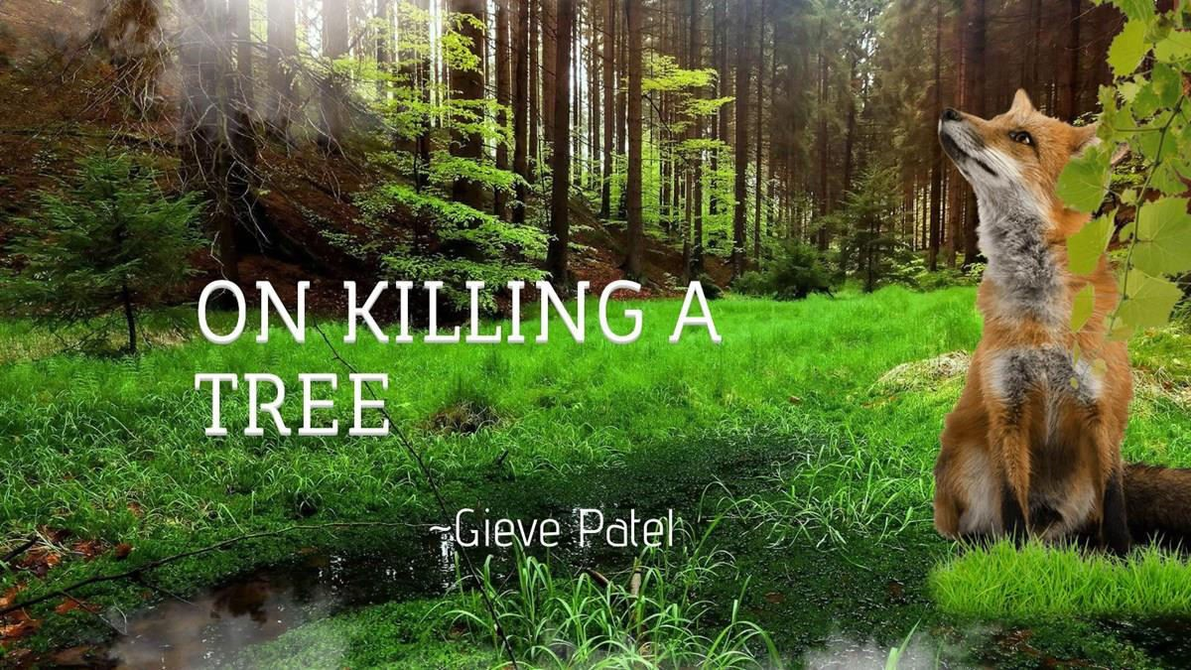
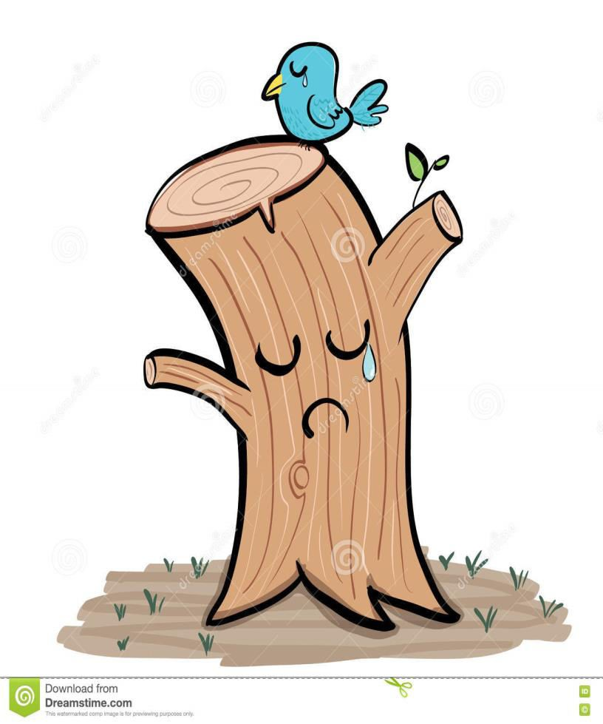
https//englishnectar.blogspot.com

Slide 2
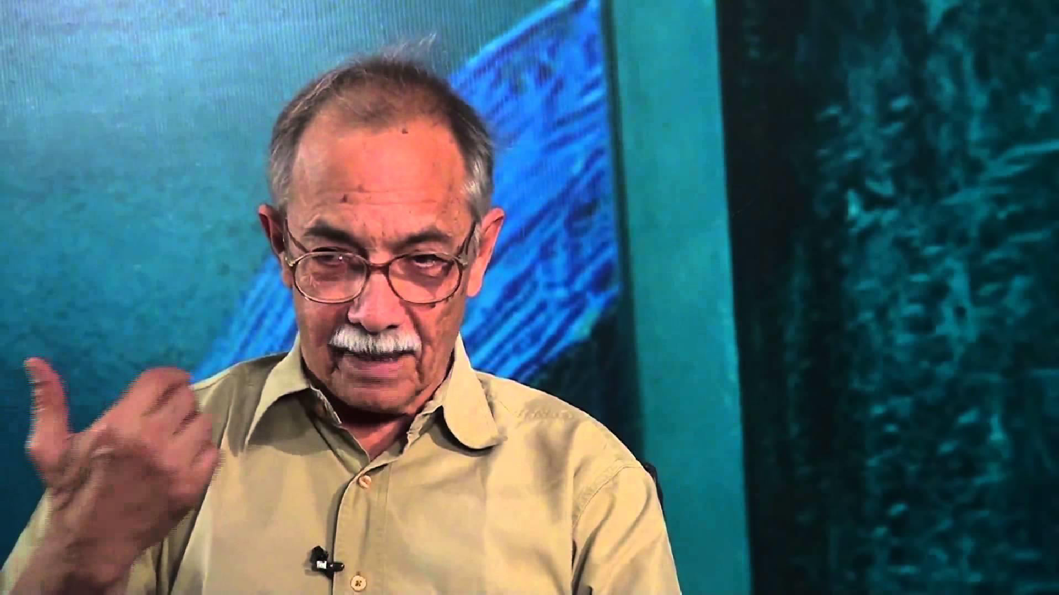
INTRODUCTION TO GIEVE PATEL

Slide 3
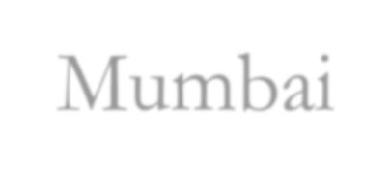
https//englishnectar.blogspot.com
Gieve Patel was born on 18th August, 1940 in Mumbai
He is a poet, playwright, painter, actor, and doctor.
His poems speak of deep concern for nature and
expose men’s cruelty to it.
On Killing a Tree is from the volume of “Poems’’,
which was published by Nizzim Ezekiel in Mumbai.

Slide 4
PATEL’S PAINTINGS
https//englishnectar.blogspot.com

Slide 5
Most of Patel’s poem centre on
human body as he is a doctor.
https//englishnectar.blogspot.com

Slide 6
He is closely associated with
https//englishnectar.blogspot.com

Slide 7
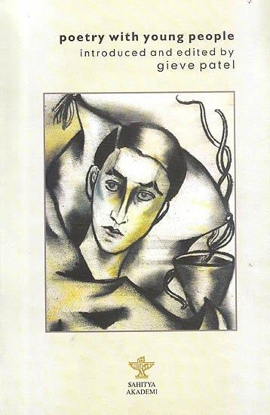
HE CONDUCTS POETRY WORKSHOP IN
RISHI VALLEY SCHOOL FOR CHILDREN.
https//englishnectar.blogspot.com

Slide 8
Poems (1966)
How Do You Withstand, Body?
(1976)
Mirrored Mirroring (1991)
https//englishnectar.blogspot.com

Slide 9
Princess
Savakasa
Mr. Behram
https//englishnectar.blogspot.com

Slide 10
Evening Forensic Medicine
From Bombay central Urban
Old Man’s Death

Slide 11
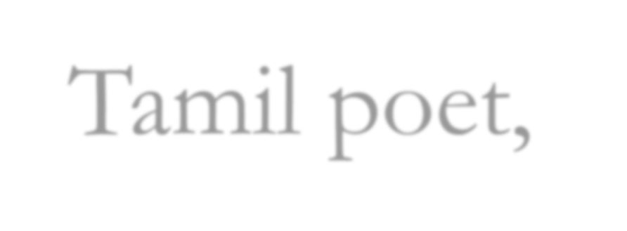
Motivation
Tamil poet, Vairamuthu’s lyrics on மரம்
https://www.youtube.com/watch?v=9-Q0ma0uACs
https//englishnectar.blogspot.com

Slide 12
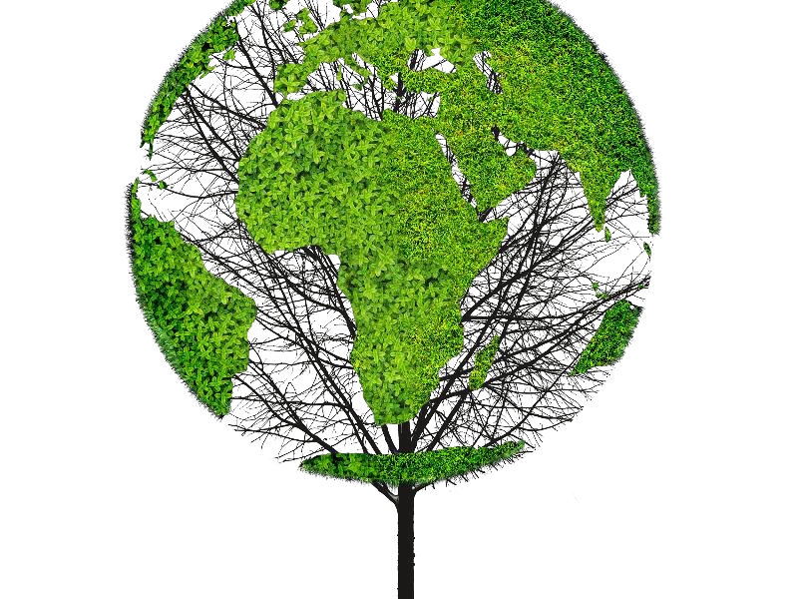
STANZA 1
https//englishnectar.blogspot.com
jab- a quick stab
consuming- to use
crust- surface of
earth
Leprous- covered with scales
Sprouting- a new growth on a plant
“It takes much time to kill a tree, Not a simple jab of the knife Will do it. It has grown
Slowly consuming the earth, Rising out of it, feeding Upon its crust, absorbing Years of sunlight, air, water, And out of its leprous hide Sprouting leaves.”

Slide 13
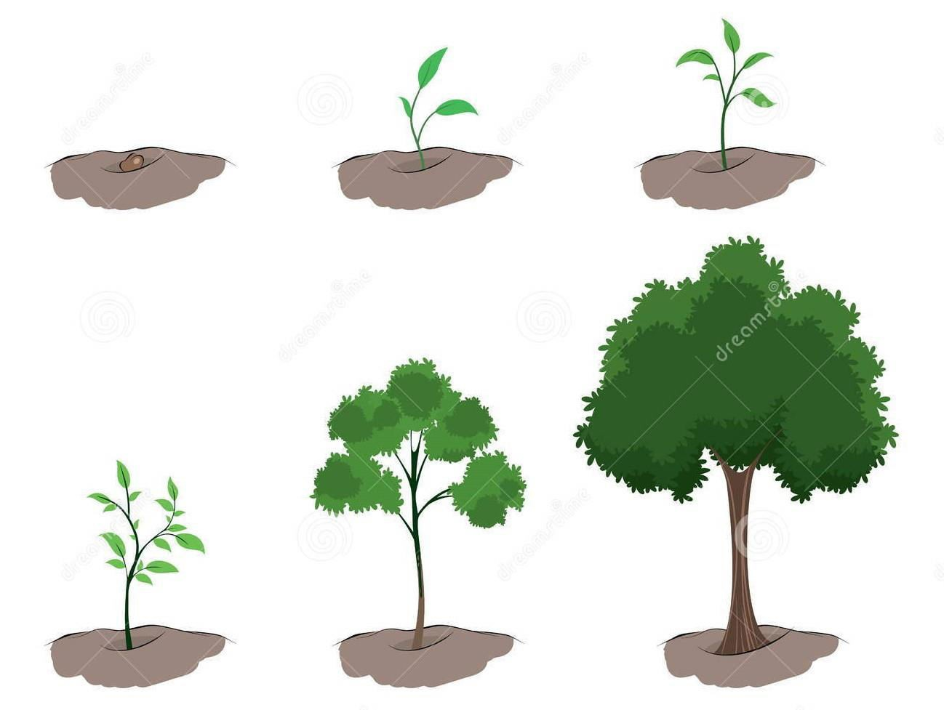
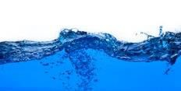
The seed grows into a tree after multiple stages of growth.
https//englishnectar.blogspot.com

Slide 14
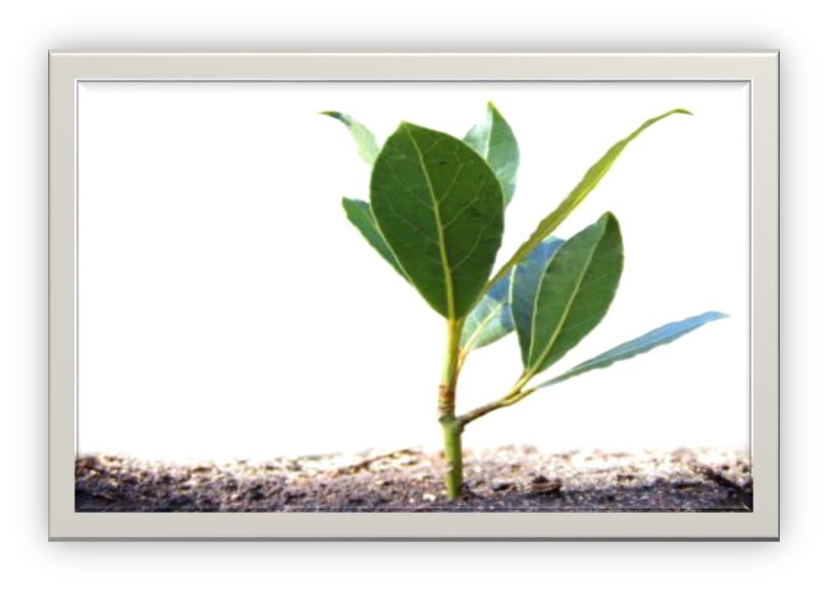
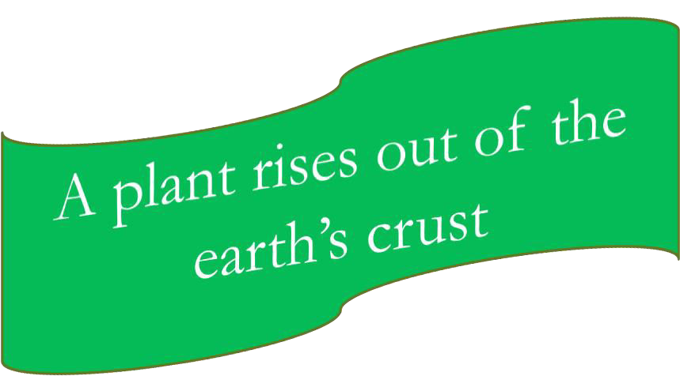
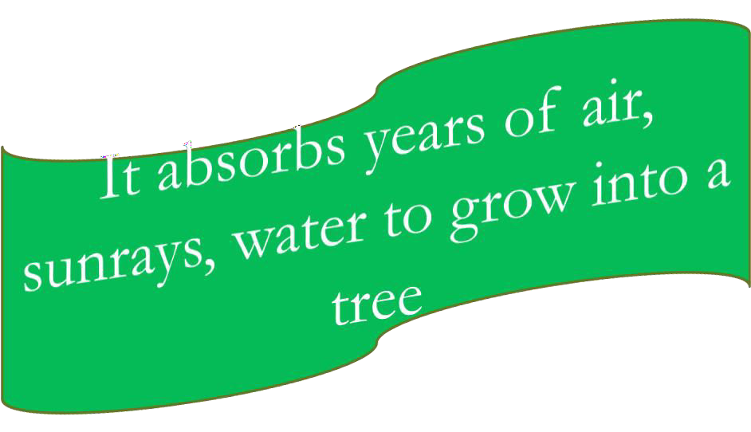

Slide 15
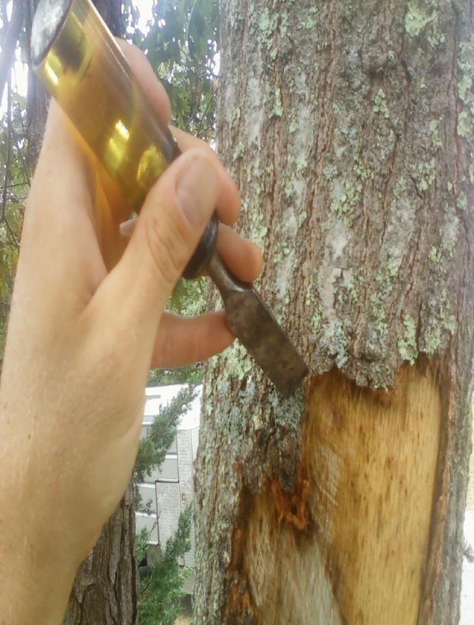
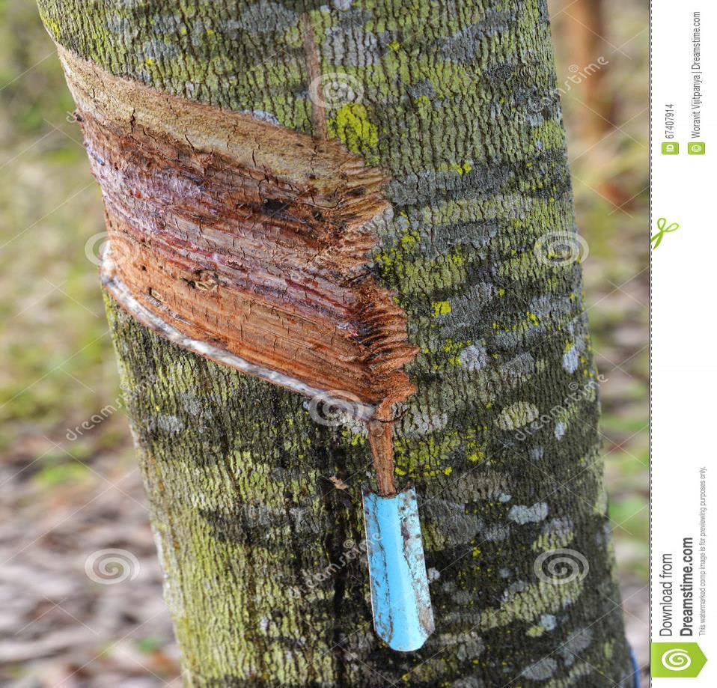
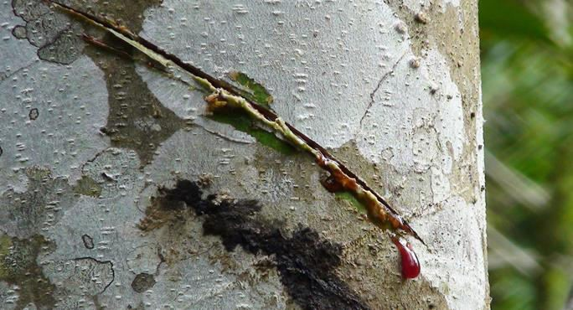
A small jab of knife can not kill tree, although it hurts it.

Slide 16
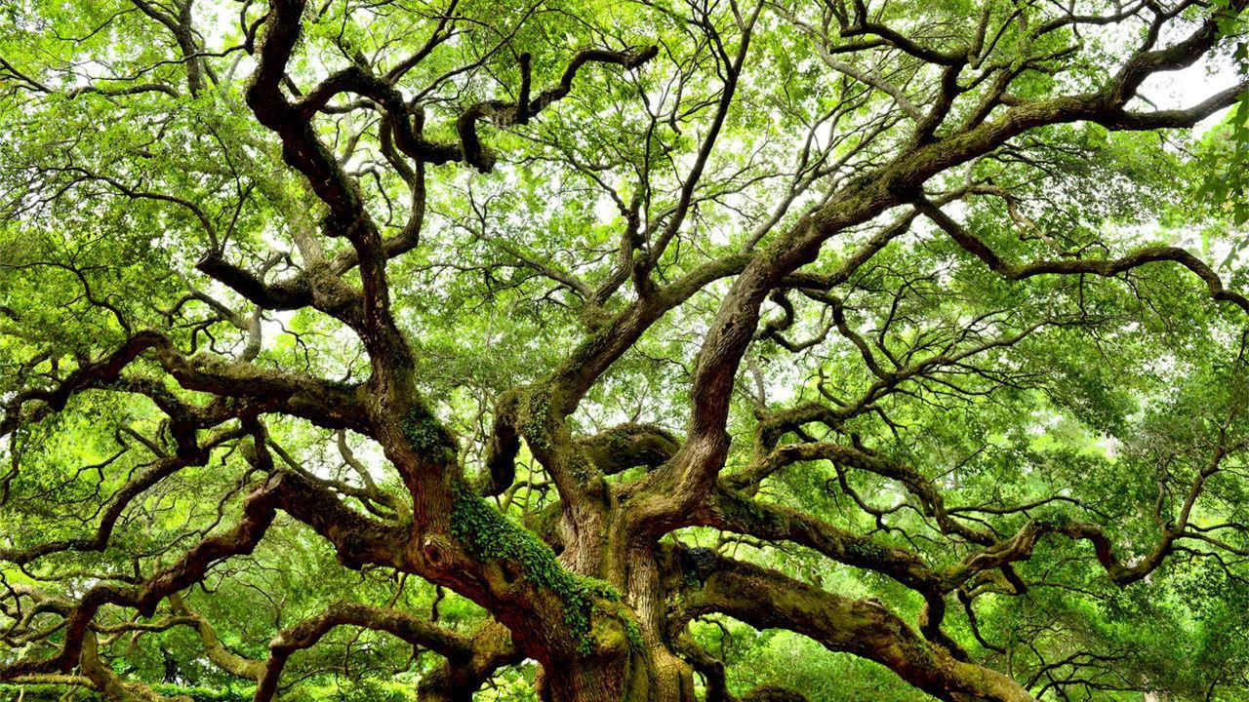
Difficulty in killing a tree is expressed
https//englishnectar.blogspot.com

Slide 17
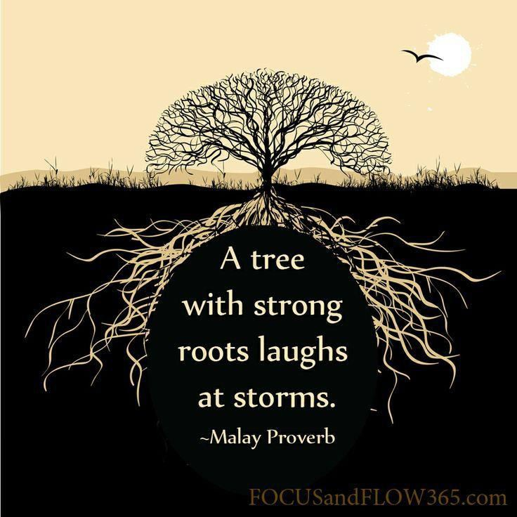
https//englishnectar.blogspot.com

Slide 18
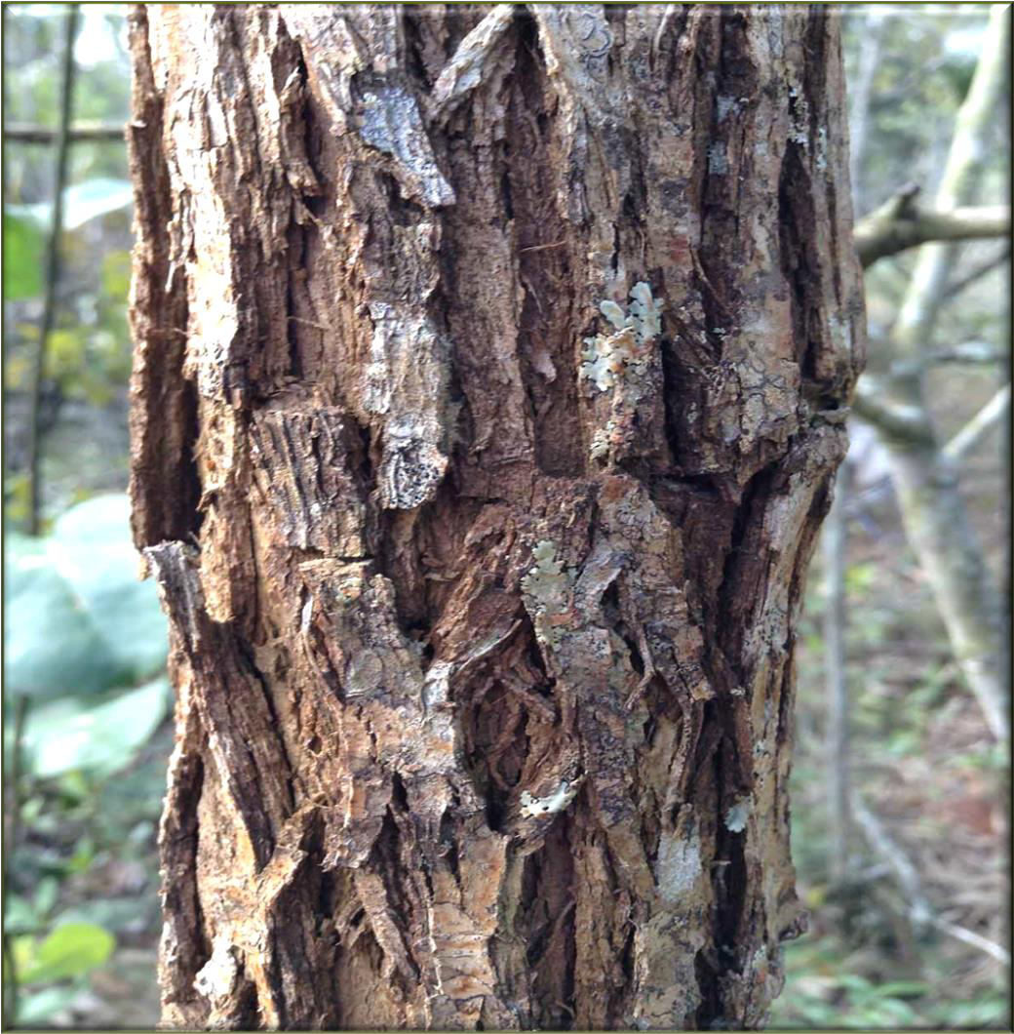
Leprous - refers here to the bark of the tree.
Hide refers to the skin of the tree that is the bark.
The barks are irregular in appearance as humans infected with leprosy appears so. Yet the leaves sprout out of it.
https//englishnectar.blogspot.com

Slide 19
Summary of the stanza 1
It tells us that killing a tree is not easy. It is very time-consuming.
A jab of a knife is not enough.
A tree grows straight out the earth, nourishing itself on the nutrients found in the earth, along with years of sunlight, water, and air.
And even though the bark looks irregular and scaly, leave and
branches sprout of it.
https//englishnectar.blogspot.com

Slide 20
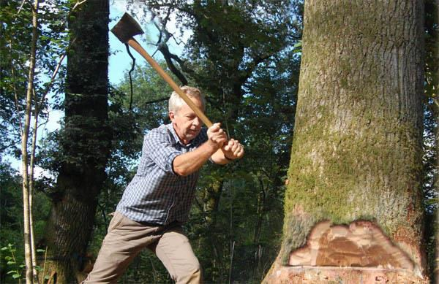
STANZA 2
https//englishnectar.blogspot.com
Meanings: Hack and chop- blow with axe Heal- to become better
Curl- spiral Twig- a small thin branch of a tree
Miniature- small in size
“So hack and chop
But this alone won’t do it. Not so much pain will do it. The bleeding bark will heal And from close to the ground Will rise curled green twigs, Miniature boughs
Which if unchecked will
expand again
To former size.”

Slide 21
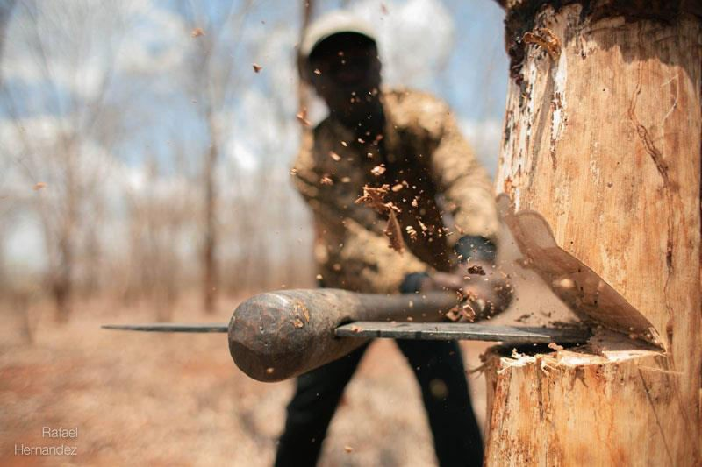
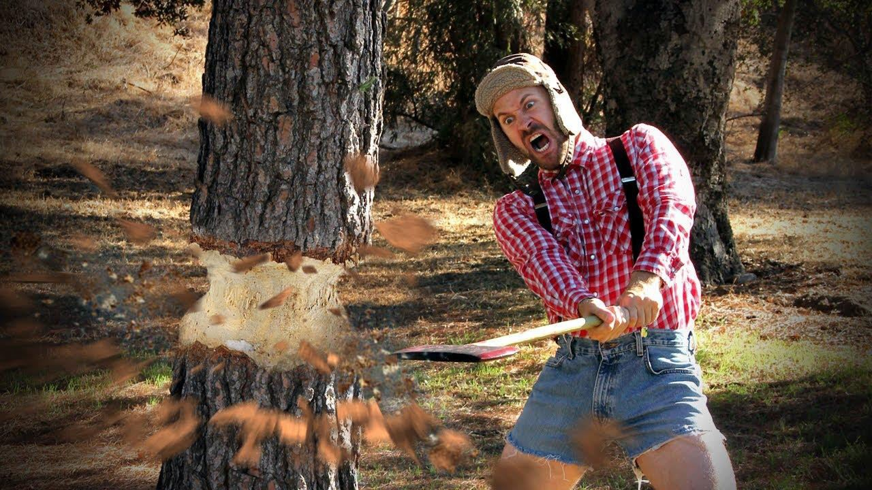
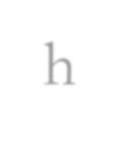
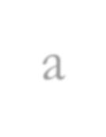
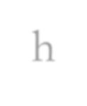
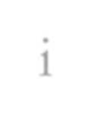
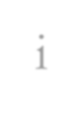
h a c k i n g
c h
o
p p i n g
chopping
Blowing the branches and trunk of the tree with an axe will not completely kill tree. Even they can’t create much pain to the tree. The poet uses the word “kill” in the poem instead of “destroy”. Because he treats the trees as humans.
https//englishnectar.blogspot.com

Slide 22
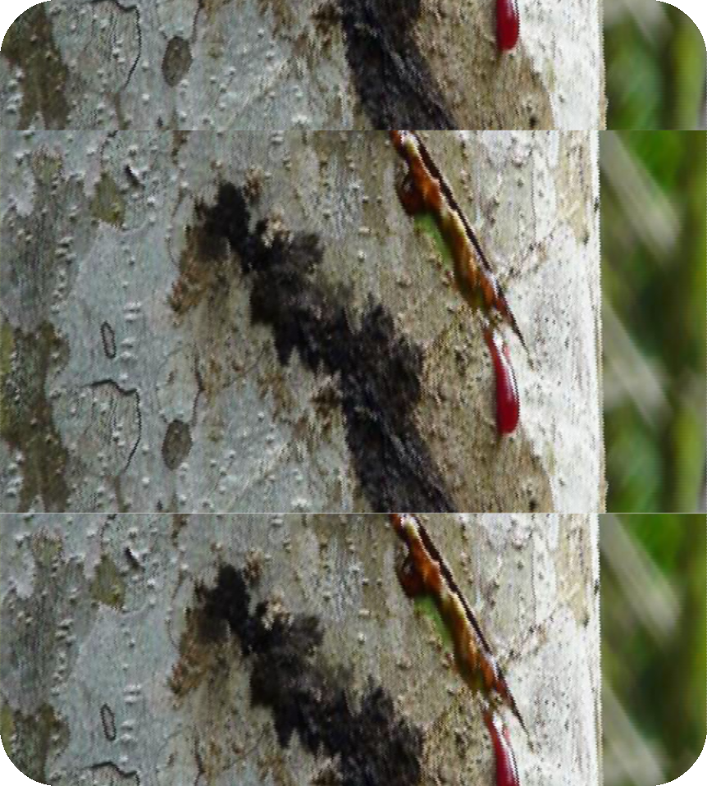
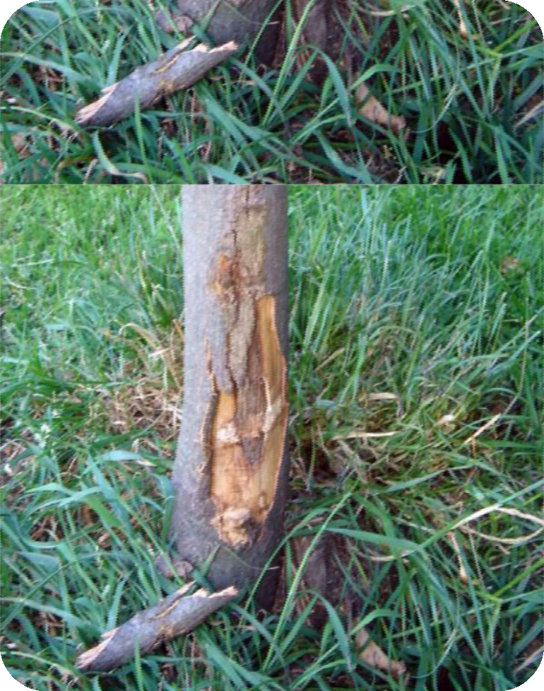
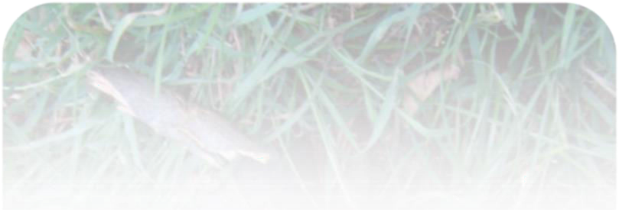
The bleeding bark will heal itself in due course of time.
https//englishnectar.blogspot.com

Slide 23
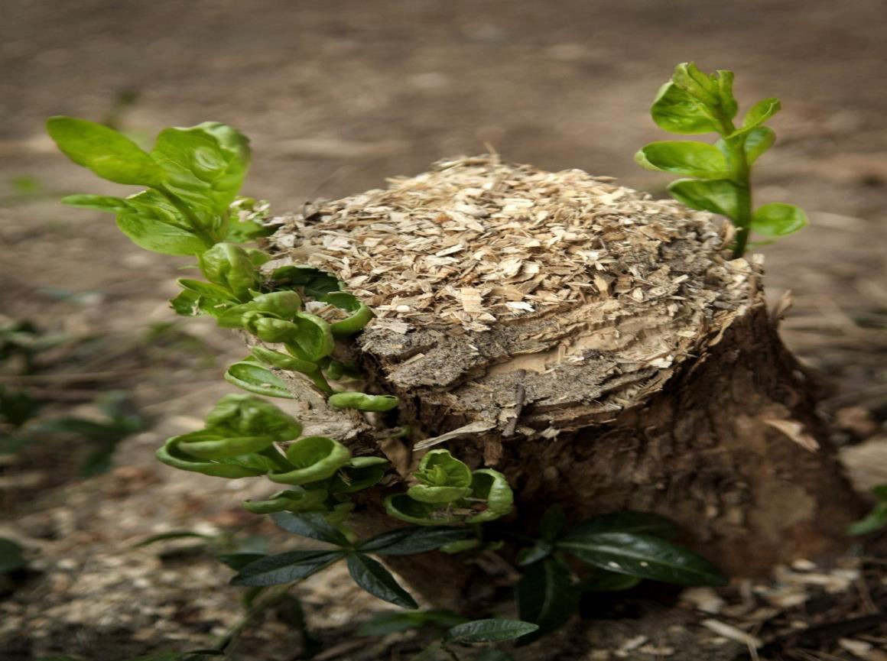
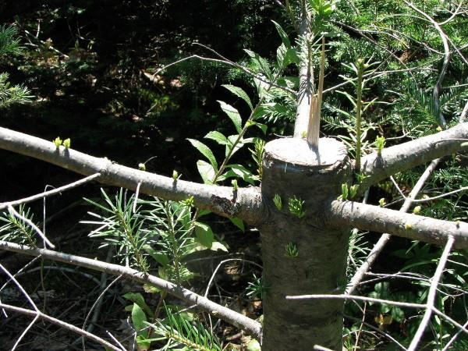
https//englishnectar.blogspot.com
Even if you harm, damage, cut the branches, the miniature boughs will grow to their
former stage if you leave them unattended after your brutal cut.

Slide 24
Summary of the stanza 2
Chopping off a bough is not enough to bring a tree down.
These jabs may inflict pain on the tree but the pain is not enough to kill it.
The ‘bleeding bark’, the part where it has been wounded or where a bough is chopped off, will heal with time.
New green twigs will grow again; boughs chopped off will be replaced by new boughs, which will grow into their former size.
https//englishnectar.blogspot.com

Slide 25
Stanza 3
https//englishnectar.blogspot.com
“No,
The root is to be pulled out – Out of the anchoring earth; It is to be roped, tied,
And pulled out – snapped out Or pulled out entirely,
Out from the earth-cave,
And the strength of the tree
exposed, The source, white and wet, The most sensitive, hidden For years inside the earth.”
Meanings:
Pull out- to remove Anchoring earth- it gives stability and security to the root Snap- to make a breaking sound Earth cave- the surface of the earth on which the foundation is laid.

Slide 26
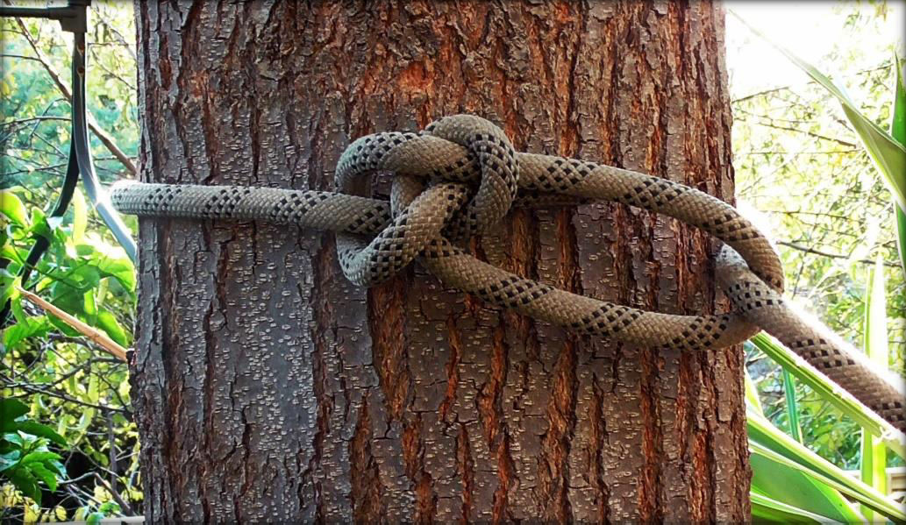
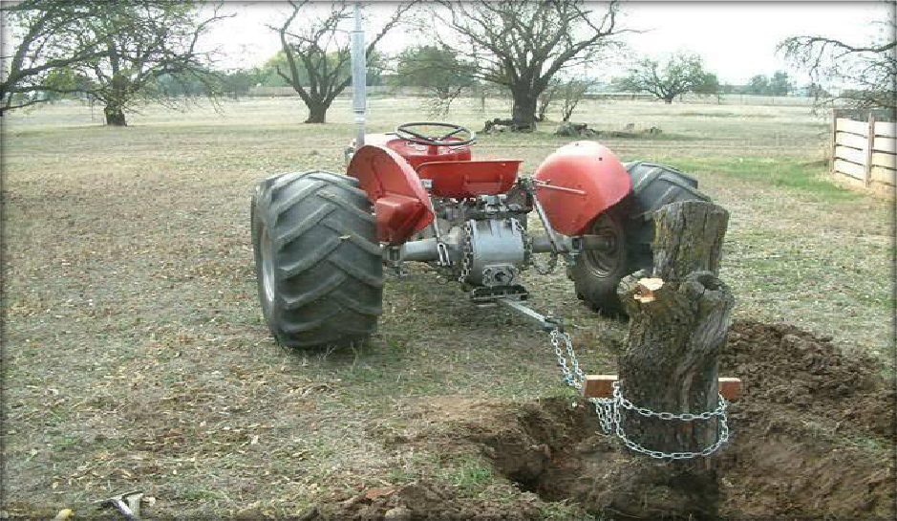
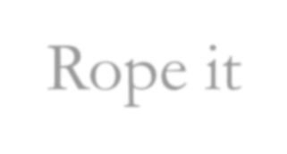
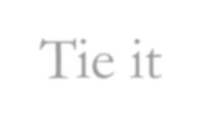
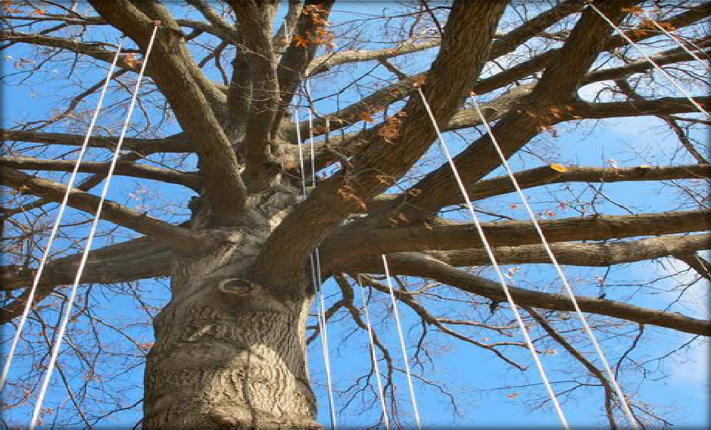
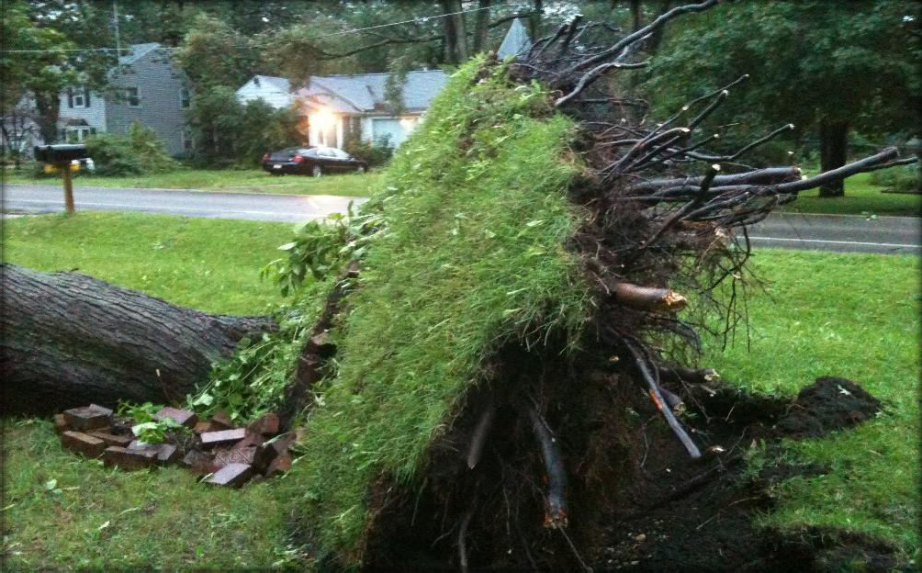
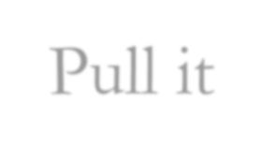
How to kill a tree?
Rope it
Tie it
Snap it
Pull it

Slide 27
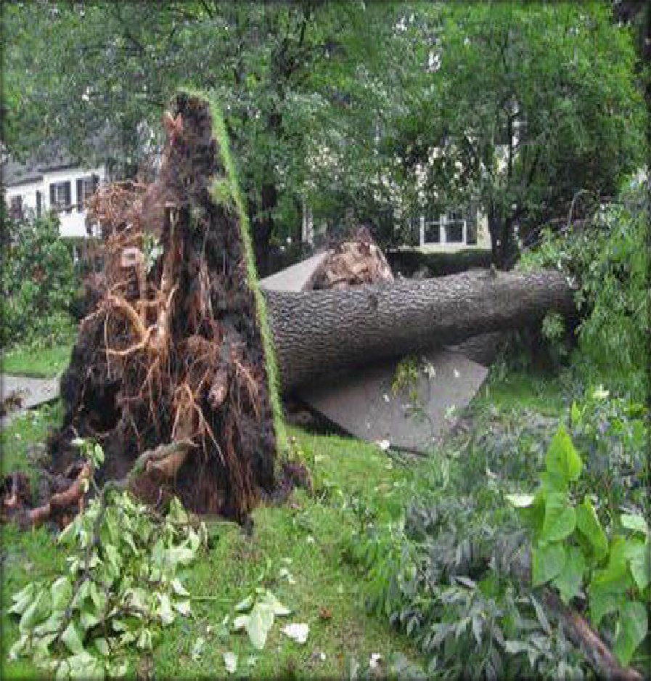
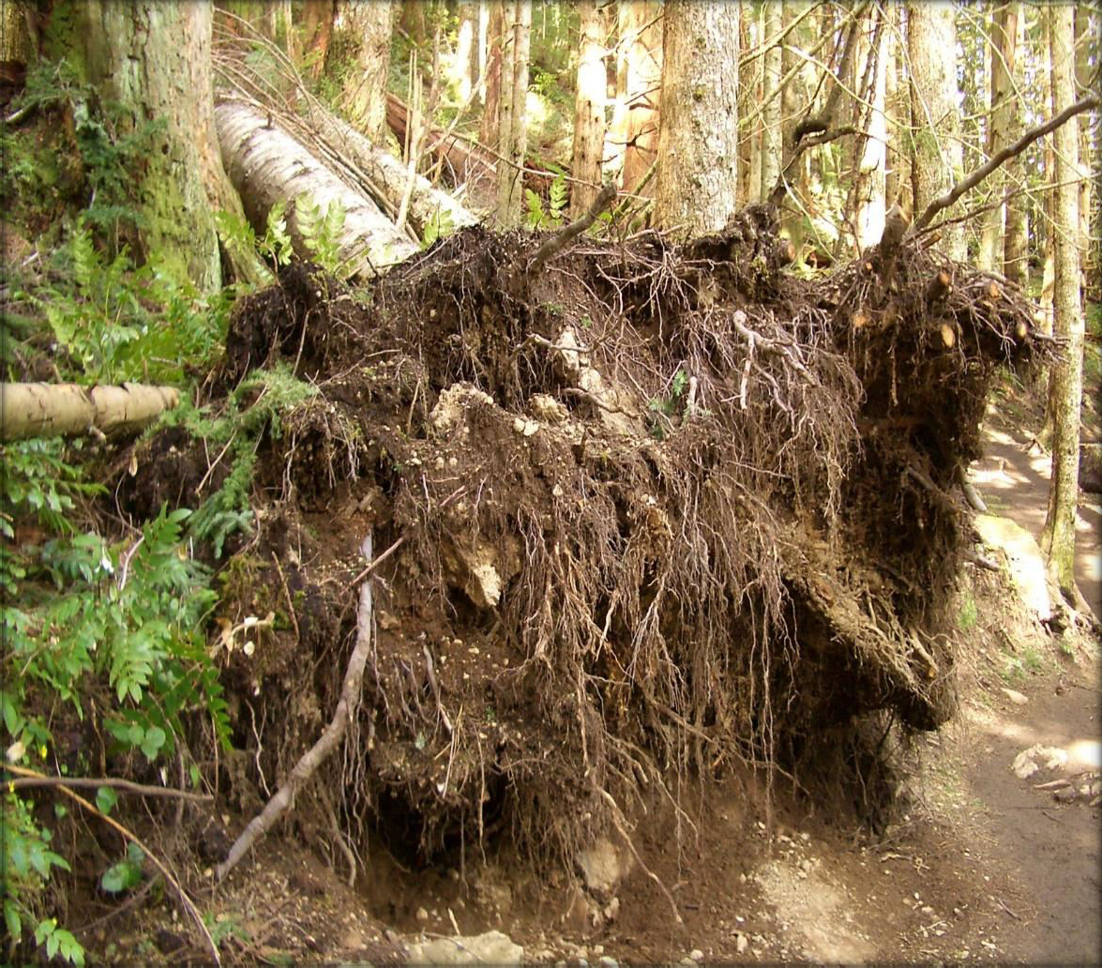
https//englishnectar.blogspot.com
We need to pull the tree out entirely from the earth cave

Slide 28
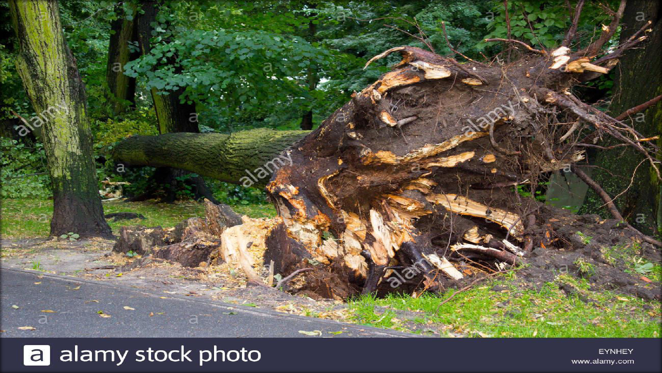
https//englishnectar.blogspot.com
When we pull out tree, the strength of the tree is exposed. The source of tree, white and wet, hidden inside the earth for years is also exposed.

Slide 29
Summary of the stanza 3
In this stanza, the poet explains how a tree could be killed. He says that the root has to be pulled out to kill a tree.
The root, which is the source of a tree’s life, must be pulled out of its cave, in order to mortally harm the tree.
By ‘earthcave’ the poet means the point, deep inside the earth, where the
root is attached.
Once the center, the life source- the root is exposed, the tree becomes weak.
The source is described as white and wet, probably alluding to tree sap
which is a white liquid.
https//englishnectar.blogspot.com

Slide 30
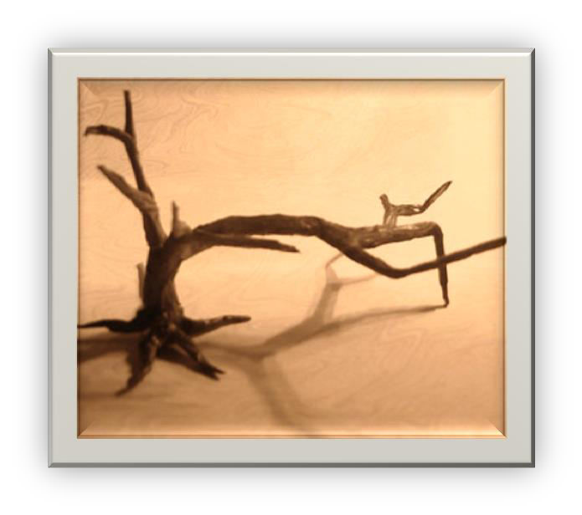
Stanza 4
https//englishnectar.blogspot.com
Scorching – brown discolouration on the leaves by heat
Choking- unable to breath freely
Twisting- to injure by bending
- tending to destroy
Withering
“Then the matter Of scorching and
choking In sun and air,
Browning, hardening, Twisting, withering, And then it is done.”

Slide 31
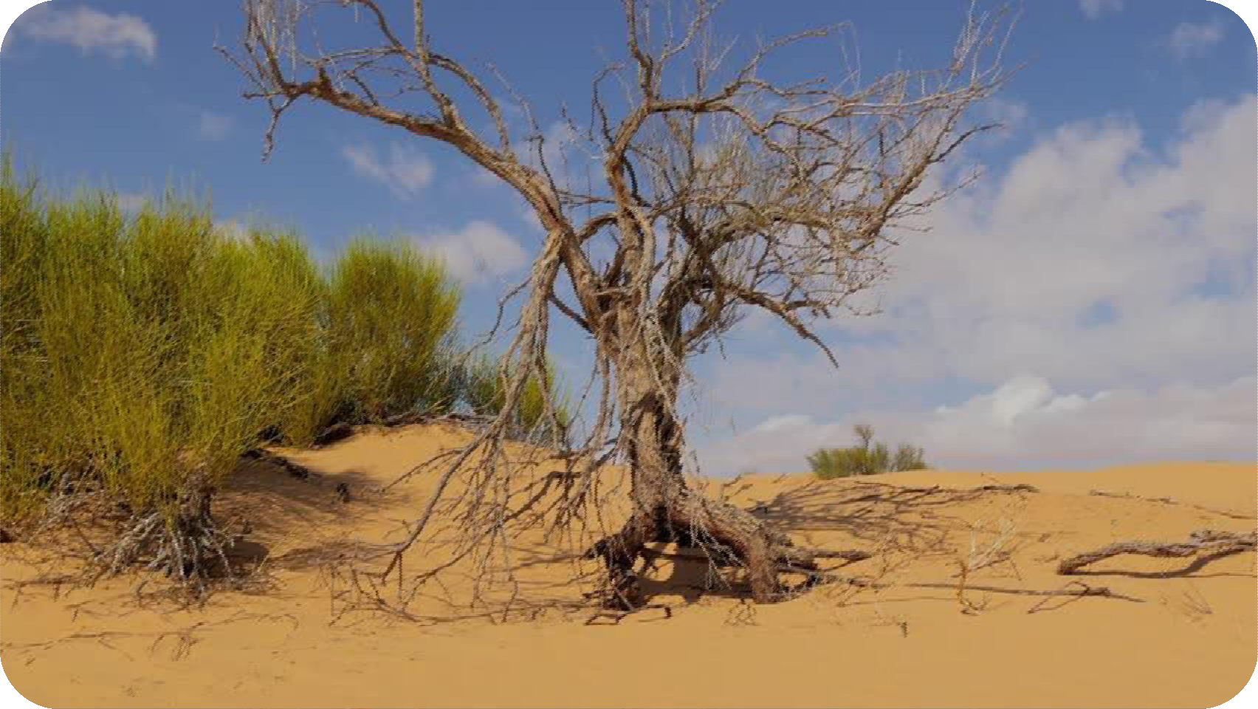
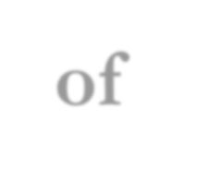
https//englishnectar.blogspot.com
The tree is exposed to scotching of Sun

Slide 32
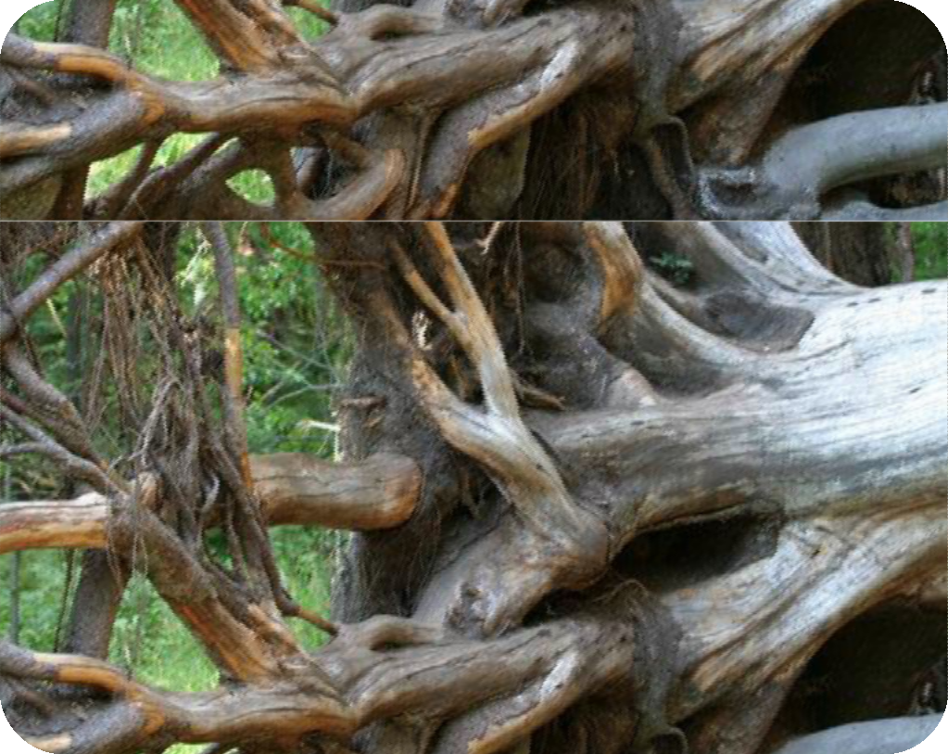
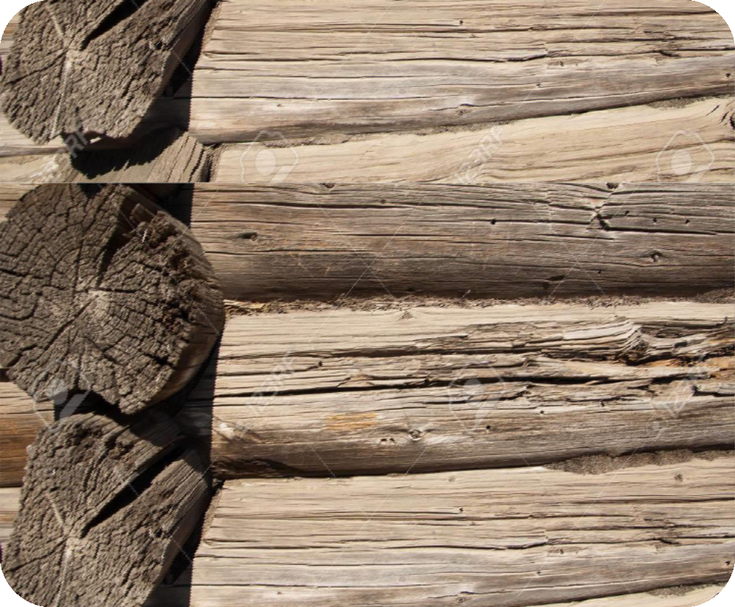
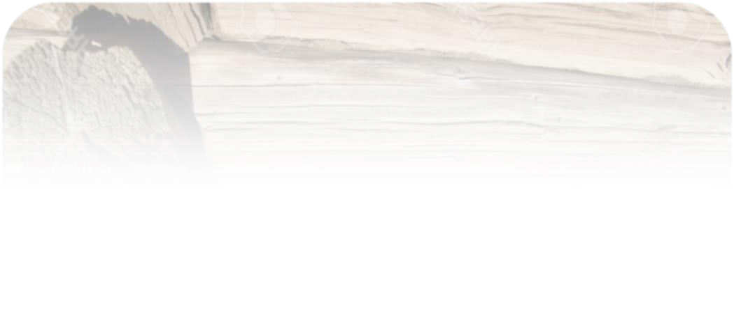
The tree appears to be browning and hardening
https//englishnectar.blogspot.com

Slide 33
Summary of the stanza 4
The exposed life source, which when left open to the sun and air, will be scorched due to the heat and the air won’t be able to reach the scorched places to relieve it of the heat.
Slowly, it will start to become brown, with all the softness fading out leaving a hard, lifeless remainder behind.
With time, it will start to wither, become dry and bent out of shape, leaving a corpse where a tree used to be.
In short, the exposure will leave the root vulnerable to all vagaries of
weather, which will ultimately weaken the tree and kill it.
https//englishnectar.blogspot.com

Slide 34
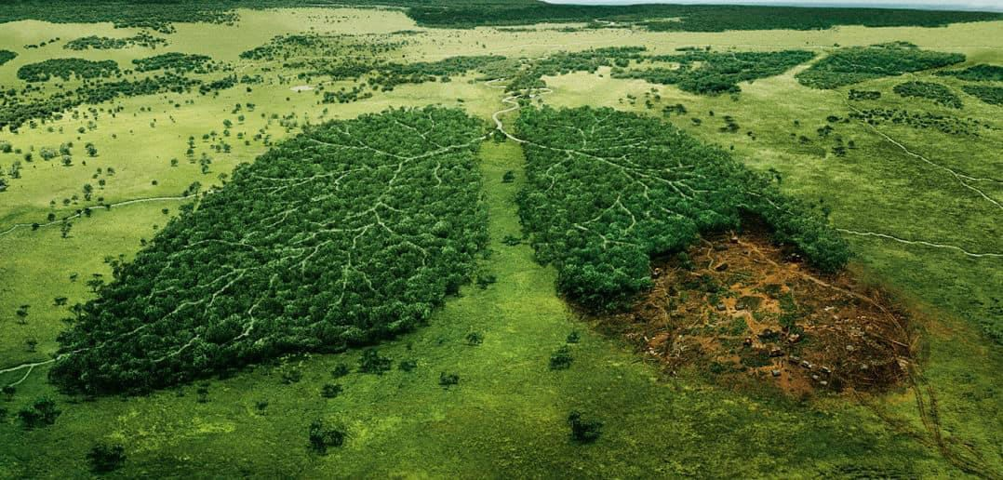
Theme
1.Deforestation
https//englishnectar.blogspot.com

Slide 35
2.Pain
https//englishnectar.blogspot.com

Slide 36
https//englishnectar.blogspot.com
Throughout the poem, the tree is treated as human being. Trick of Reverse psychology is used.

Slide 37
Mood of the poem Tone of the poem
sadness
https//englishnectar.blogspot.com

Slide 38
https//englishnectar.blogspot.com

Slide 39
Sources: http://studentlaboratory.blogspot.com https://beamingnotes.com https://www.enotes.com
https://wikipedia.org Thanks

Slide 40
Video Resources
QR Code video given at page 146- TNSCERT Poem:
https://diksha.gov.in/play/collection/do_312585401655779328215374?dialCode=212CJH&c ontentId=do_31260025576938700812790
QR Code video given at page 148- E- Glossary:
https://diksha.gov.in/play/collection/do_312585401655779328215374?dialCode=212CJH&c ontentId=do_31259756634375782421142
Gieve Patel’s Biography:
https://www.youtube.com/watch?v=PWsrVf0J7DU
Summary of the poem:
https://www.youtube.com/watch?v=XWAhFbyVVbM

